Slide 1


||JAI SRI GURUDEV|| ADICHUNCHANAGIRI UNIVERSITY Faculty of Engineering Management & Technology BGS Institute of technology
Final Presentation
On
“An End-to-End Workflow for Enhancing Text Classification Models with Generative AI-aided Data Augmentation”
Presented by: Under the guidance of:
HITHASHREE HP Ms . SMITHA K
LAVANYA BN Asst. Professor
SUMA T Dept. of AI& ML

Slide 2
CONTENTS
Abstract
Introduction
Literature Review
System Analysis
System Requirement
System Architecture
Implementation
Result & snapshots
Conclusion
References

Slide 3
ABSTRACT
Built a system to classify one text into multiple categories using BERT.
Improved performance using data augmentation (paraphrasing, summarizing)
Preprocessed data and trained model using BCE loss and AdamW optimizer.
Evaluated model using Micro-F1 and Macro-F1 scores.
Deployed system using a Flask web app for real-time prediction.

Slide 4
INTRODUCTION
Text classification means automatically assigning categories or labels to a given text based on its content.
In real life, One text can have multiple labels and less data for some labels.
We used BERT + data augmentation to improve learning .
Our model is Better accuracy in predicting multiple labels.
It better Handles multi-label, improves rare labels, gives real-time output.
OBJECTIVE:
To improve text classification performance using AI-generated data.
To combine original and generated data for effective model training.
To compare Generative AI augmentation with traditional EDA techniques.
To analyze model performance and understand predictions using Explainable AI .

Slide 5
LITERATURE REVIEW
SL.NO | TITLE | AUTHOR & YEAR | METHODOLOGY USED | LIMITATIONS
1 | Back-translation for Text Classification | PLOS ONE, 2025 | Translate-to-other-language and back to create paraphrases | Translation cost; possible domain drift
2 | Systematic Review of LLM-based Augmentation | EDM, 2025 | LLM-based augmentation, rewriting, RAG, hybrid methods | Quality control challenges; bias and cost concerns .

Slide 6
3 | Impact of Text Data Augmentation Across Dataset Sizes | Elsevier Procedia CS, 2024 | Multiple DA methods across small/medium/large datasets | Effects vary across models; not universally beneficial
4 | Graph-Augmented Prompt Tuning for Low-resource Text | arXiv, 2023 | Combines graph structure with continuous prompt tuning | Complex and resource -heavy

Slide 7
SYSTEM ANALYSIS
Existing System
In the existing system, models like BERT are trained directly using the available data. When the dataset is imbalanced, models do not learn all topics properly.
Train a classifier using original dataset.
Handle imbalance using Oversampling simple EDA techniques (synonym replacement, random swap, deletion)
Disadvantages of Existing System
Poor Minority-Class Performance: Rare labels receive limited training examples.
Limited Data Diversity: Oversampling only duplicates existing samples without adding new information.

Slide 8
Proposed System
The proposed system integrates Generative AI–aided data augmentation with multi-label classification.
Controlled-length generation (e.g., 50 / 150 / 256 words).
Training advanced models such as BERT ,CNN ,HiSAN.
Advantages of Proposed System
Higher Semantic Diversity: Synthetic samples add meaningful.
Faster Convergence: Attention-based models learn faster due to richer training data.
Practical & Scalable Solution: Reduces dependency on expensive manual data collection.

Slide 9
SYSTEM REQUIREMENTS
Hardware Requirements
Processor: Intel i5 or above
RAM: 8 GB minimum (16 GB recommended)
Storage: 256 GB or more
GPU : Helpful for faster model training
Software Requirements
Operating System: Windows / Linux / macOS
Programming Language: Python
Libraries:PyTorch / TensorFlowTransformers (BERT)Scikit-learn, Pandas, NumPy
Framework: Flask
Tools: Jupyter Notebook / VS Code

Slide 10
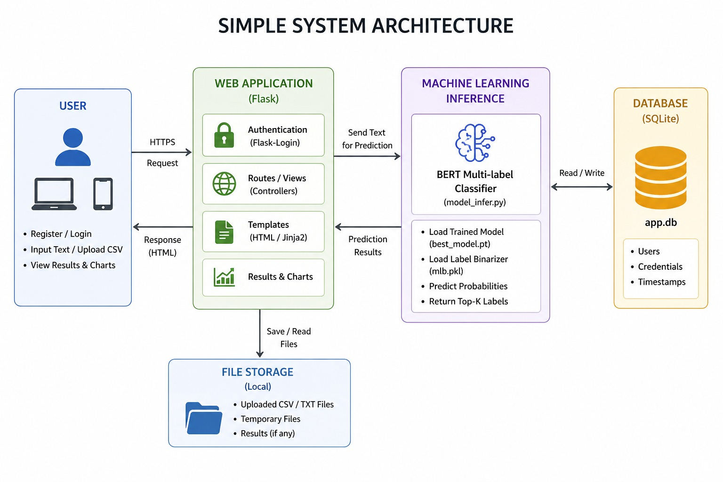
System Architecture

Slide 11
Text classification is the process of turning raw text into useful categories. First, text is collected from sources like emails or social media. Then it is cleaned by removing unnecessary words, fixing missing parts, and making the text consistent (like using lowercase). After that, the text is converted into numbers so a computer can understand it. A model is then trained to classify the text into categories, such as spam or not spam. Finally, the model is tested using measures like accuracy to check how well it works on new data.

Slide 12
IMPLEMENTATION
DATASET & PREPROCESSING
Used Reuters multi-label dataset, removed unwanted samples, and cleaned the text (handled nulls and formatting)
Converted labels into binary form, split data into train/validation/test, and saved label mapping (mlb.pkl)
AI-BASED DATA AUGMENTATION
Improved data by generating extra samples for minority labels using techniques like paraphrasing, expansion, summarization, and back-translation
Cleaned generated data (removed duplicates/irrelevant text) and combined it with original data to form final datase
TOKENIZATION & MODEL
Converted text into BERT inputs (input_ids, attention_mask) using tokenizer
Used BERT with Dropout, Linear, and Sigmoid layers to predict multiple labels with probability scores

Slide 13
TRAINING & EVALUATION
Trained model using Binary Cross Entropy loss and AdamW optimizer with backpropagation, saving the best model
Evaluated using Micro-F1 and Macro-F1 and compared results with other methods
DEPLOYMENT & INFERENCE
Developed a Flask app with login, dashboard, and options for single and batch predictions
For prediction: input → model → probabilities → apply threshold/Top-K, using saved model and label file

Slide 14
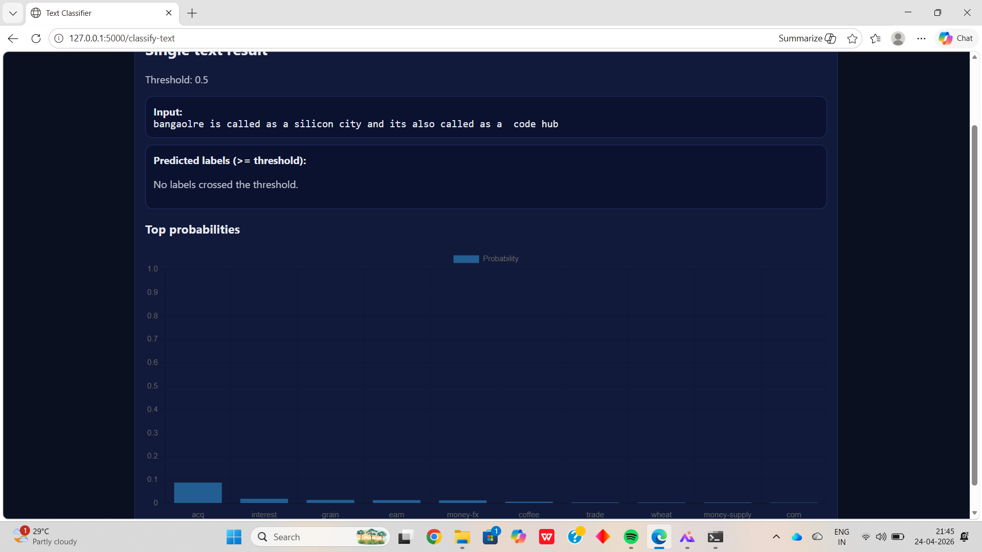
RESULTS & SNAPSHOTS
Our system takes input text from the user and first converts it into a format that the model can understand using BERT tokenizer. Then the trained BERT model processes the text and generates probability scores for each category like trade, acq, etc. After that, we apply a threshold to select only the labels with high confidence, and those are shown as the final output.

Slide 15
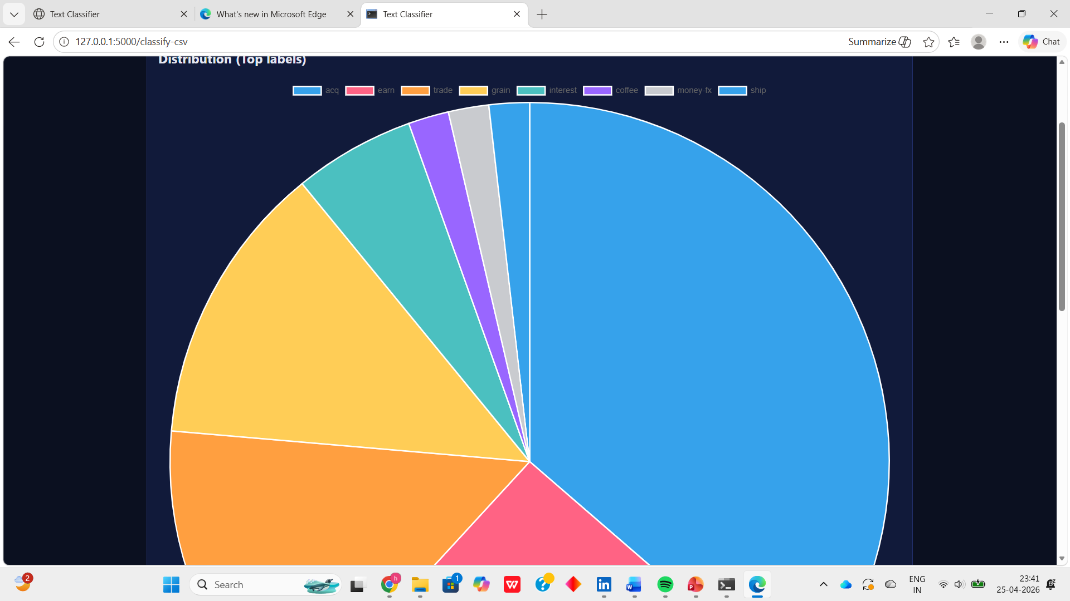

Slide 16
CONCLUSION
In this project, we successfully developed a multi-label text classification system using the BERT model. We improved the performance of the model by applying data augmentation techniques like paraphrasing and summarization, which helped in handling less frequent labels. The data was properly cleaned, processed, and used to train the model effectively. We evaluated the model using appropriate metrics to ensure good performance. Finally, we deployed the system using a Flask web application, allowing users to give input text and get predictions in real time. Overall, the project provides an efficient and practical solution for classifying text into multiple categories.

Slide 17
REFERENCES
[1] Z. Wang, Y. Pang, Y. Lin, and X. Zhu,
“Adaptable and reliable text classification using large language models,” IEEE International Conference, 2024.
[2] P. Trust and R. Minghim,
“A study on text classification in the age of large language models,” Machine Learning and Knowledge Extraction, 2024.
[3] S. P. K. Veeranki, A. Abdulnazar, D. Kramer, et al.,
“Multi-label text classification via secondary use of large clinical real-world data sets,” Scientific Reports, 2024.
[4] S. Molitorys, B. Pilot, and K. Smyrak,
“Text Classification,” CEUR Workshop Proceedings (IVUS), 2024.
[5] E. De Santis, A. Martino, F. Ronci, et al.,
“From bag-of-words to transformers: A comparative study for text classification in healthcare discussions in social media,” IEEE Transactions, 2024.

Slide 18
[6] L. Xiao, Q. Li, Q. Ma, J. Shen, Y. Yang, and D. Li,
“Text classification algorithm of tourist attractions subcategories with modified TF-IDF and Word2Vec,” PLOS ONE, 2024.
[7] H. Zhao, H. Chen, T. A. Ruggles, Y. Feng, D. Singh, et al.,
“Improving text classification with large language model-based data augmentation,” Electronics, 2024.
8] S. Liu, S. Liu, L. Sha, Z. Zeng, et al.,
“Annotation guideline-based knowledge augmentation: Towards enhancing large language models for educational text classification,” IEEE Transactions, 2025.
[9] H. Sakai and S. S. Lam,
“Large language models for health care text classification: Systematic review,” JMIR AI, 2026.
[10] M. Cesarini, L. Malandri, F. Pallucchini, A. Seveso, et al.,
“Explainable AI for text classification: Lessons from a comprehensive evaluation of post hoc methods,” Springer (Cognitive Studies), 2024.

Slide 19
THANK YOU

